Slide 1
THE MYTH OF THE MINOTAUR,
DAEDALUS AND ICARUS
IS IMPORTANT BECAUSE OF:
The role of the isle of Crete in the Mediterranean sea in the 3rd-2nd millennium B.C.
The theme of the labyrinth as a symbol of the difficulties and troubles of life
Ariadne’s thread as a symbol of safety
Daedalus as a symbol of the power of the human mind
Icarus as a symbol of failure due to an impossible achievement/challenge
Si ringrazia la prof. Francesca Gitto per i suggerimenti preziosi offerti

Slide 2
AEGEUS
King of Athens
THESEUS
Aegeus’s son
THE MINOTAUR
Minos’s stepson
ARIADNE
Minos’s daughter
ICARUS
Dedalus’s son
THE LABYRINTH
DAEDALUS
The builder
MINOS
King of Crete

Slide 3
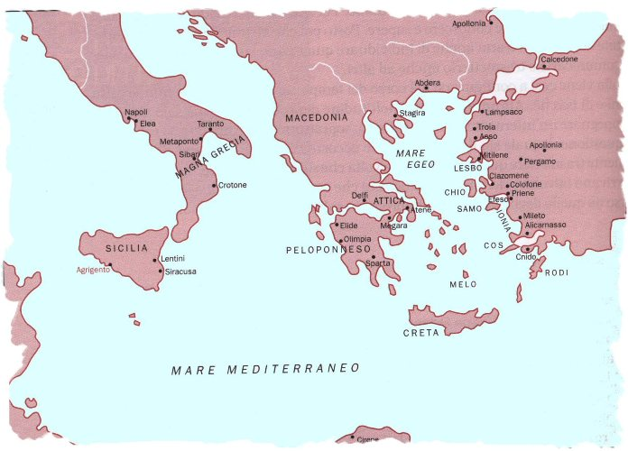
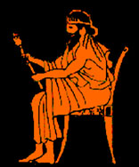
MINOS
Minos was the king of Crete. We do not know if “Minos” was his real name or if the word only meant “king”. Anyway he was a good and powerful king and peacefully ruled over his people with justice.
He had two children:
a daughter, Ariadne
a stepson, the Minotaur
It was Minos who sent for Daedalus and bade him build the Labyrinth.
BACK

Slide 4
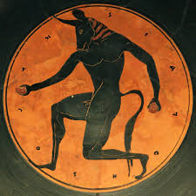
THE MINOTAUR
The Minotaur was a terrible monster. He had a human body, but a bull’s head. He only ate human flesh and when he grew up he became cruel and dangerous. This is why Minos decided to send for Dedalus, the best architect in the world, in order to build a prison for the monster, so that he could not escape and terrify the people of Crete any more.
Anyway, every single year 14 young people (7 boys and 7 girls) were sent by boat from Athens to Crete to be fed to the Minotaur. This shows that Crete was of paramount importance in the east Mediterranean sea at that time and Athens was dominated by it.
BACK

Slide 5
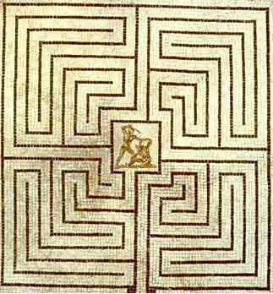
THE LABYRINTH
The Labyrinth was a very mysterious and fascinating building. It was a maze with long corridors and tunnels all twisted together, so that the people who entered it were not able to find their way out any more. They could not but get lost in it, until the Minotaur found them and devoured them.
The Minotaur himself was not allowed to escape and this was due to Daedalus’s ingenuity and intelligence.
BACK

Slide 6
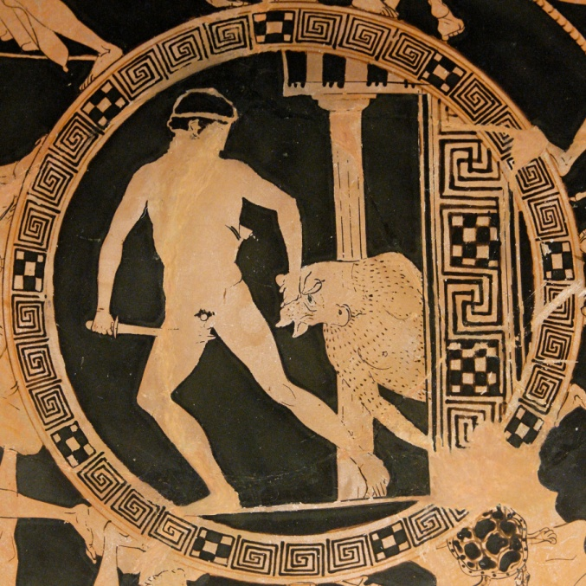
THESEUS
Theseus was the son of Aegeus, king of Athens. He decided to put an end to the terrible tradition of sending young people to Crete in order to be fed to the Minotaur. Then he sailed to the island and killed him. By the way, he could not have been able to come out of the labyrinth if he had not been given the thread by Ariadne. However Theseus did not keep the promises he had made: before leaving from Athens, he had promised his father that he would come back with white sails in case of victory and
with black sails in case of defeat. He forgot to change the sails and Aegeus, seeing from far away his son’s ship coming with black sails, took his life. Theseus had also promised Ariadne to whisk her away and to marry her if he killed the monster, but he let her down, and leaft her crying and swearing at him on the beach. When he came back to Athens he became the new king of the town.
BACK

Slide 7
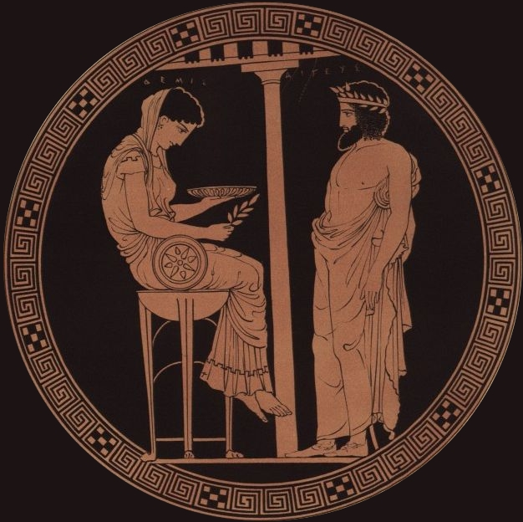
AEGEUS
Aegeus was the old king of Athens and Theseus father. When Theseus decided to sail to Crete he was desperate since he thought he would be bereft of his son: defeating the Minotaur was definitely an impossible achievement. By the way, he wanted to know his son’s destiny in advance, then he begged Theseus to make him a promise: if he won, he should put white sails on his ship, whereas in
sails should be black if he died. As Theseus forgot to change the sails, Aegeus, seeing the black sailed ship arriving, thought Theseus had been killed and took his life by throwing himself down from the walls of Athens. He fell into the sea or on the cliffs and died. From then on the sea was called “Aegean” and Theseus became the new king of Athens.
BACK

Slide 8
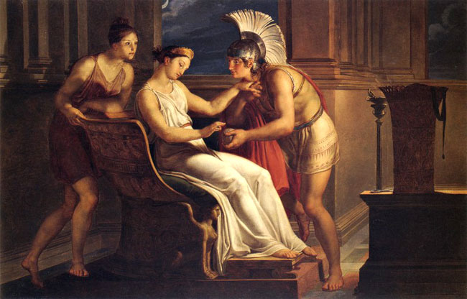
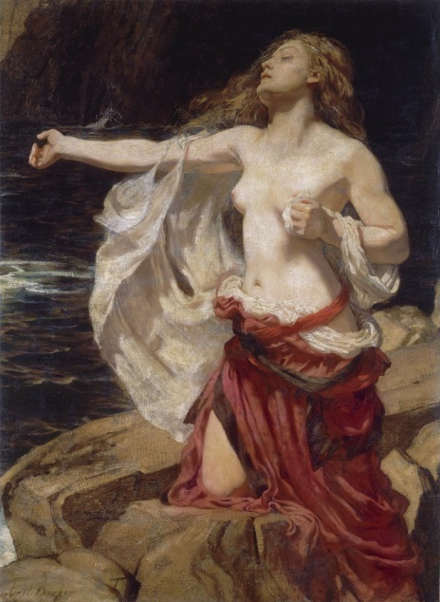
ARIADNE
Minos daughter was a beautiful and lovely girl. When Theseus arrived at Crete, she immediately fell in love with him and decided to help him by giving him her famous thread, following which the hero was able to find the Minotaur and the way back as well.
On the other hand, Ariadne made Theseus promise her that he would take her away from Crete and marry her after killing the monster. But Theseus forgot it all and left poor Ariadne alone on the beach (according to other versions of the myth he dumped her on another island, Naxos). The girl cried, shouted and swore at him, but he was far away and could not hear her. Some say that Dionysos, the god of wine picked her up later in his boat and fell in love with her.
BACK

Slide 9
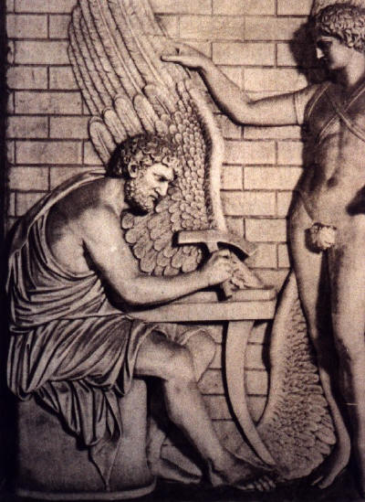
DAEDALUS
Dedalus was the best architect and engineer in the ancient world. According to Minos’ will, he built the labyrinth, but after building it he felt like being in prison himself. Minos, infact, did not want him to go away to spread the secret of the labyrinth all about the Mediterranean area. Daedalus could go all through Crete island, but he was not permitted to escape from it.
After the Minotaur was killed, Daedalus felt finally free to go away. Since he had no boat, he built himself and his son Icarus two pairs of wings using birds feathers kept together with wax. He was the first man who had the idea to fly in the air like a bird.
BACK

Slide 10
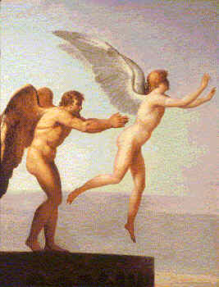
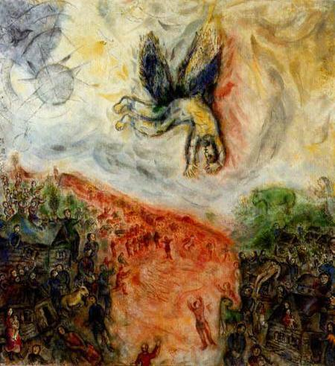
ICARUS
After building the wings, Daedalus arranged them on his own back and on his son’s. Before they left, he carefully recommended that Icarus fly neither too close to the sea, as water could make the feathers wet and heavy, nor too close to the sun, which could burn him. However, arguably because of a new sense of freedom, Icarus became too self-confident and reckless. He kept flying higher and higher, until the heat of the
sun made the wax melt. His wings disentegrated and were not able to support him any more. Then he fell down into the sea and died. Daedalus was unable to save his son. He miserably called out his son’s name, but there was nothing to do. After a few days Dedalus landed in Sicily and made a sacrifice in Icarus’ memory. They say the part of the sea Icarus fell into was called Icarius sea.
BACK

